Slide 1
Kubernetes API Overview
Operator Framework Workshop

Slide 2
What we’ll discuss today
Agenda
Kubernetes API
Exploring the Kubernetes API Structure
Versioning: Alpha, Beta, and Stable
Exploring GroupVersionKind, Metadata, Spec, and Status
Subcommands, API Actions, and HTTP Methods
Optimistically Concurrent Updates
Deletion and Garbage Collection
Command Line Interaction with the API
Notes:
How its organised
Versioning
How we interact with it
Concurrency
Garbage collection
Short Exercise

Slide 3
An Operator takes advantage of what Kubernetes does best
Kubernetes API
Notes:
Advantages of Kubernetes -- declarative way to manage resources, highly available, self healing
Operatives are k8s native applications
Extensions of kubernetes that provide custom functionality for your apps

Slide 4
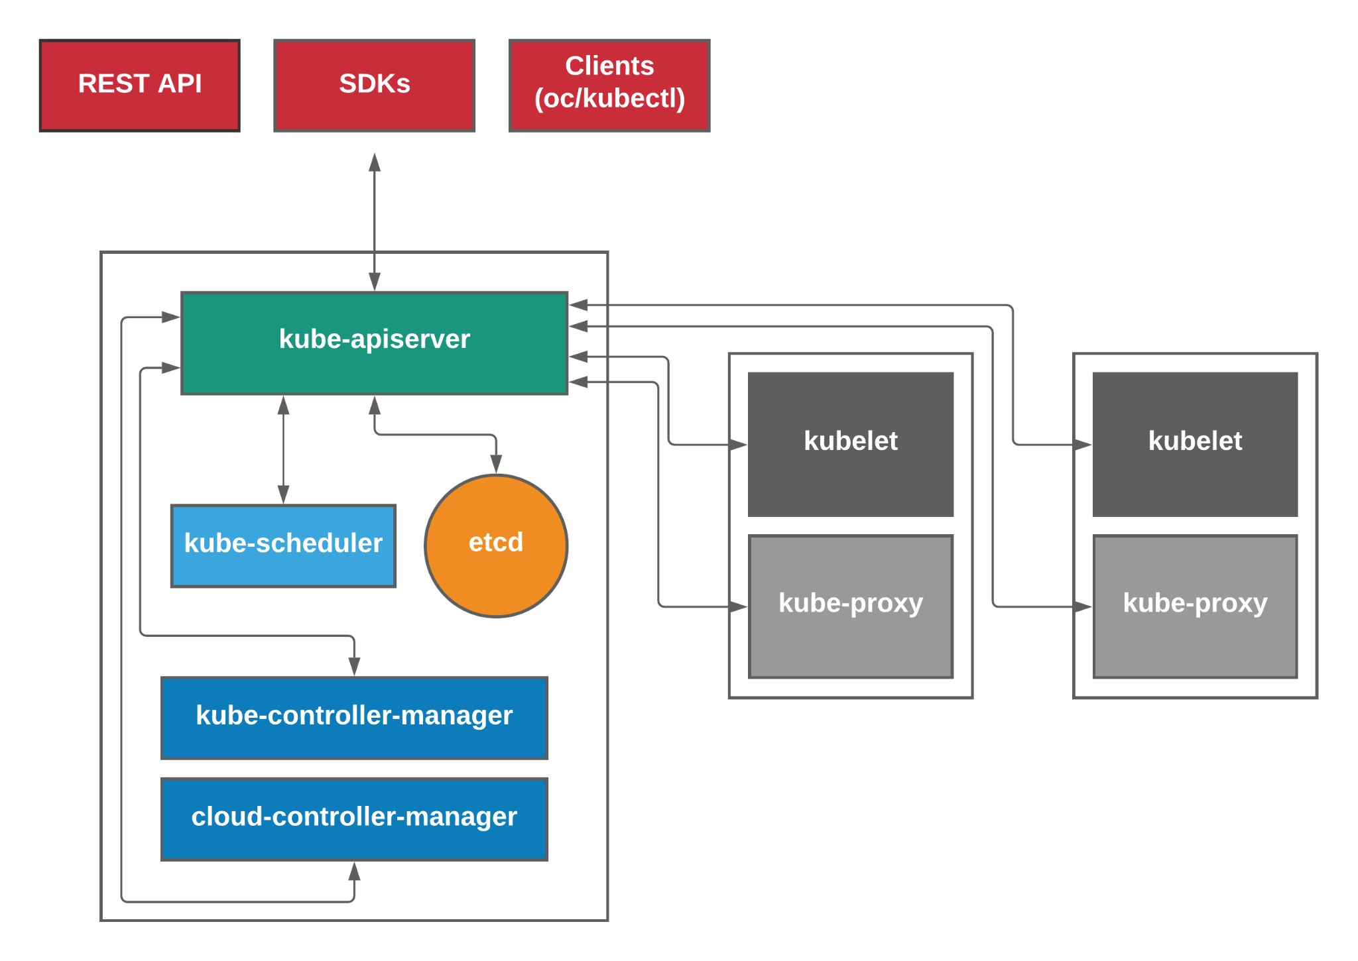
Kubernetes API
Source:
https://medium.com/@karthikeyan_krishnaswamy/overview-of-kubernetes-34d8e0e59b26
Notes:
Quick refresher of the kubernetes architecture
Top: clients
Left: control plane
Right: data plane or worker plane
Key Takeaway:
K8s is the star of the show
Everything talks to the api server to see what's going on in the cluster
Single source of truth
We will see as we progress through the material how everything works “asynchronously”

Slide 5
Control Plane (Master)
Kubernetes API
kube-apiserver
the only component that all other master and worker components directly communicate with.
validates and configures data for the api objects which include pods, services, deployments, and others.
kube-scheduler
responsible for managing the scheduling of pods.
kube-controller-manager
embeds the core control loops shipped with Kubernetes.
performs cluster-level functions like keeping track of workers and handling node failures.
cloud-controller-manager
embeds the cloud specific control loops shipped with Kubernetes.
etcd
distributed data store that persistently stores the cluster configuration.
Notes:
A bit of a brief introduction about the various components of kubernetes for those who may not be familiar
The control plane things that typically run on the master nodes
Api server
Backed by etcd
Models and serves resources in the cluster
Validates requests, provides the ability to extend kubernetes with custom resources “kinds”
Kube scheduler
filtering - resource availability, affinity rules
scoring - ranks filtered nodes
Controller manager
Control loops that watch the api for changes and perform actions to achieve the desired state
Cloud controller manager
Enables evolution of cloud specific code independently of core kubernetes functionality
Etcd is a strongly consistent resilient key value store. A 2n + 1 node cluster can tolerate the failure of n nodes

Slide 6
Data Plane (Worker)
Kubernetes API
kube-proxy
network proxy that runs on each node.
can do simple TCP, UDP, and SCTP stream forwarding or round robin TCP, UDP, and SCTP forwarding across a set of backends.
reflects services as defined in the Kubernetes API on each node.
kubelet
primary agent running on the node and registers the node with the API server.
ensures containers described in PodSpecs are running.
able to receive container manifests via File, HTTP endpoint, HTTP server
container runtime
cri-o
rkt
containerd
Notes:
Data plane consists of things that run on the worker nodes
Kube-proxy
Implements services defined in the cluster
Kubelet
Implements podspecs
Container runtime
to run pods
Non kubernetes (in the form of daemon sets)
Networking component
Device plugins that expose special hardware to kubernetes

Slide 7
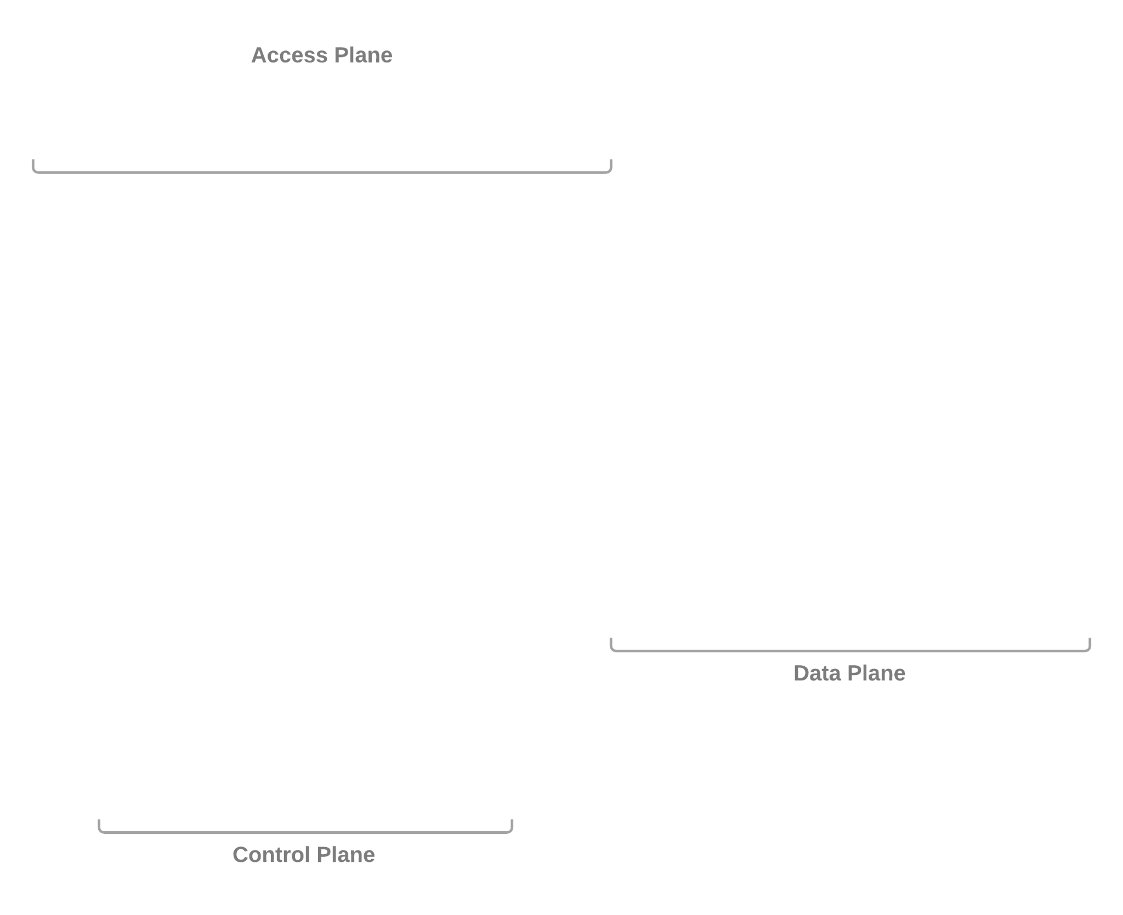
Kubernetes API
Notes:
Key Takeaway:
Various ways to interact with the kubernetes api
Http
Curl
Postman
Bit cumbersome
Official command line clients
Oc
Kubectl
Dashboards
Sdk
ex operator sdk
Go-client

Slide 8
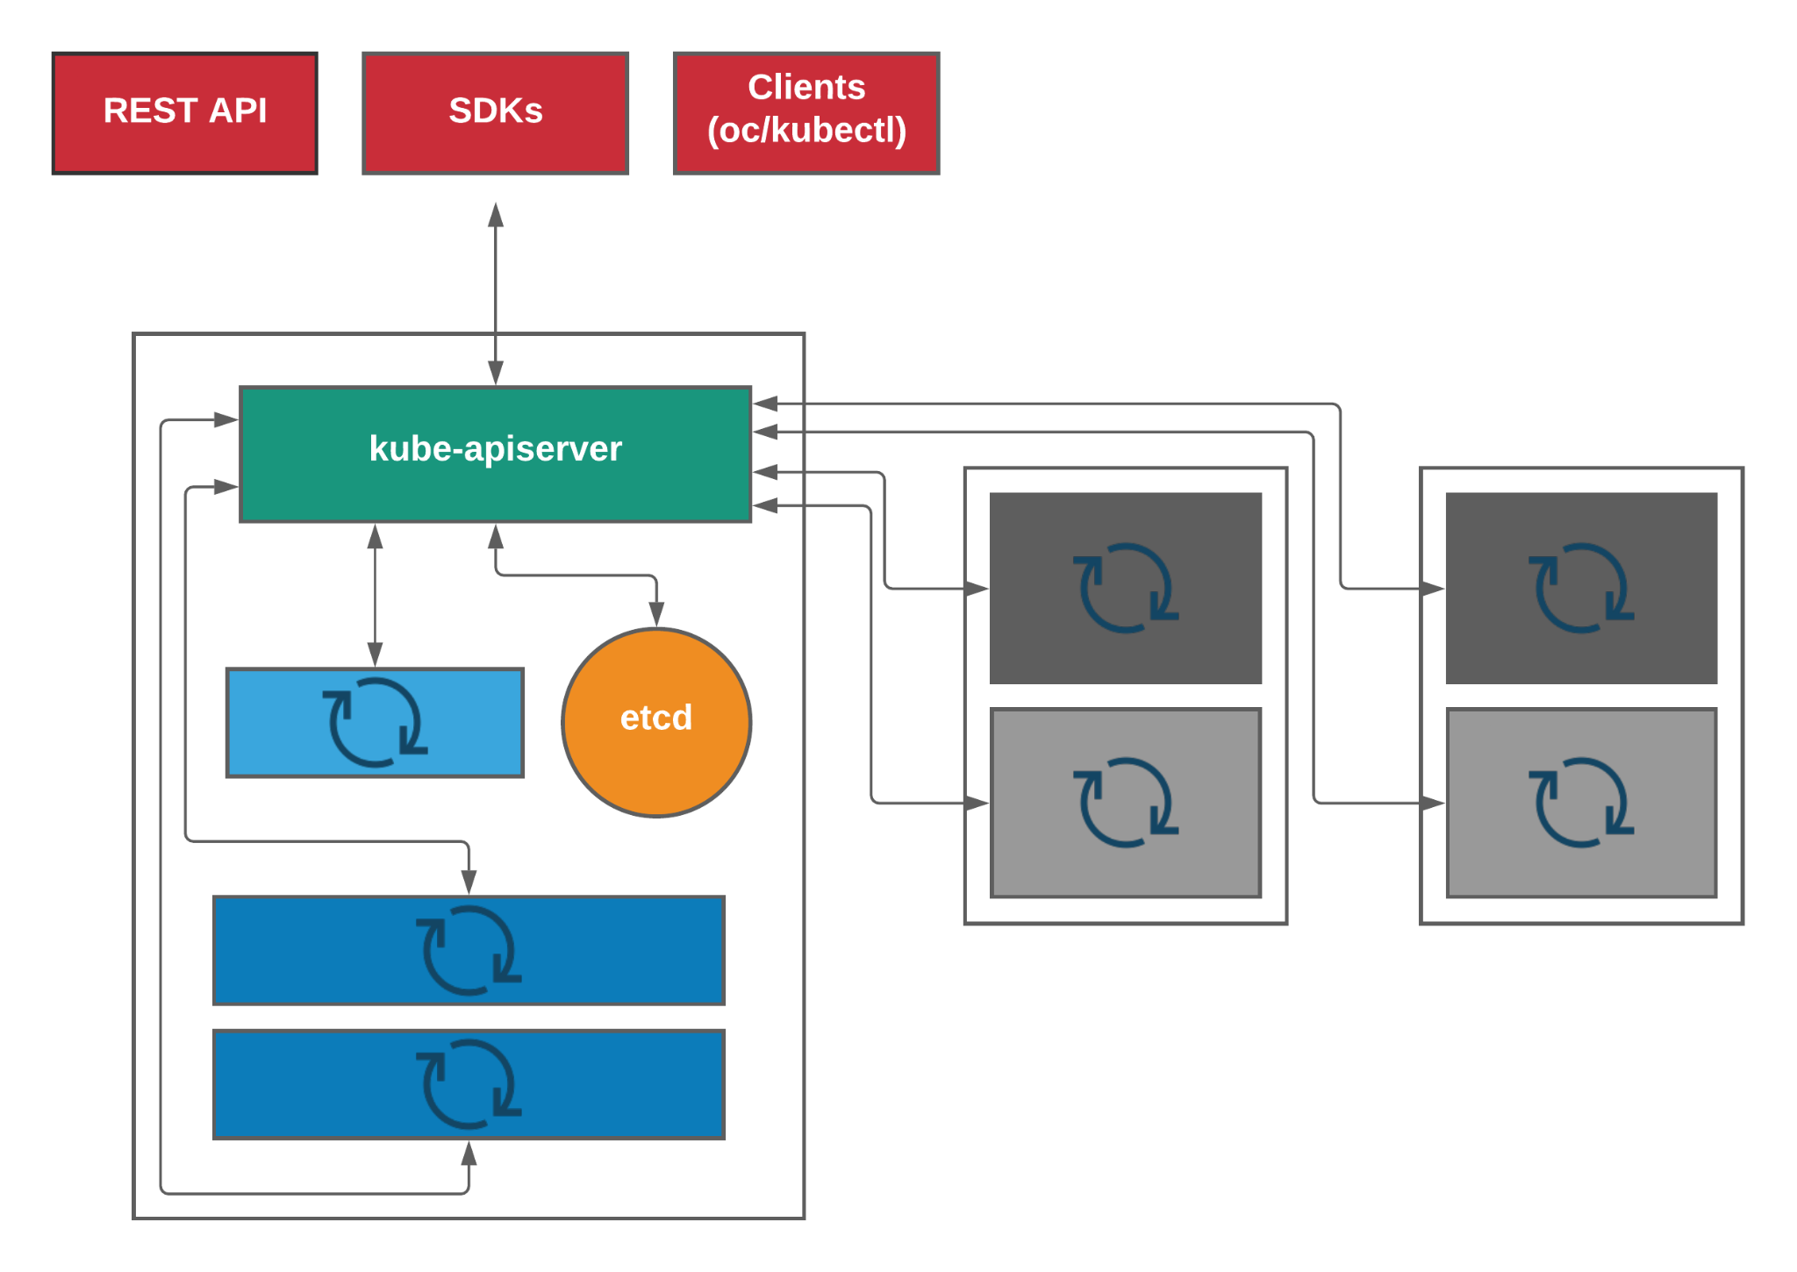
Kubernetes API
Notes:
Key Takeaway:
Everything is a control loop
Resources (status + spec) in etcd
Controllers watch the status and ensure its conforms to spec.

Slide 9
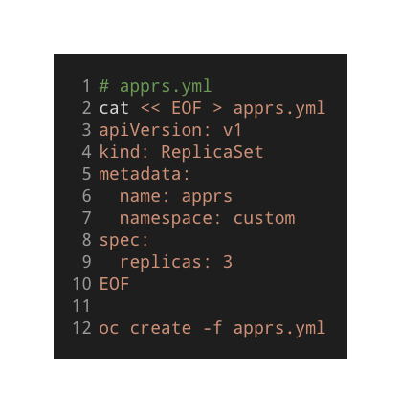
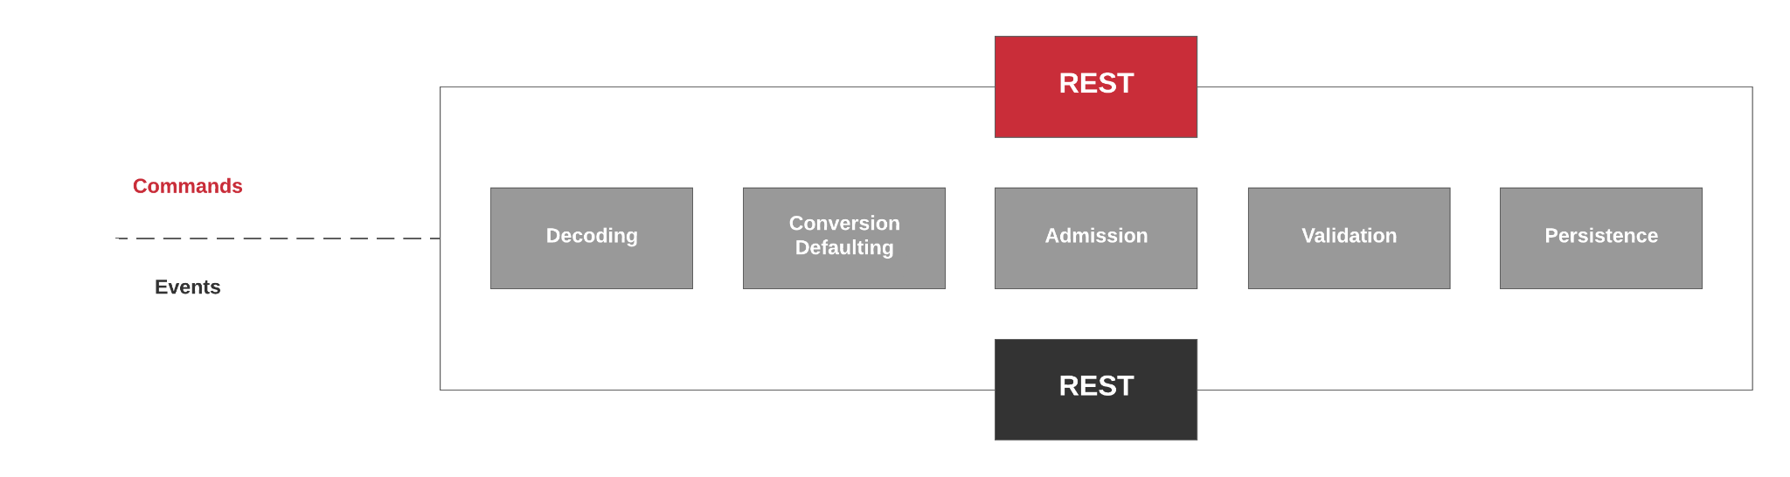

Kubernetes API
POST
ReplicaSet Controller
WATCH
Notes:
Key Takeaway: distinguishing how previously mentioned components/controllers interact with the api server
Lets take a closer look at how the api works with an example
Key Takeaway: distinguishing how previously mentioned components/controllers interact with the api server
Create resource -- not exactly a command, we interact in a declarative style
it actually represents a declaration of an intent to do something or something you want to happen in the cluster.
The api server
Admission process -- can be thought of as controlling what's allowed in the cluster
Decodes the request
Authn - who, Authz - what
Conversion, mutation ex default values, schema migration between different resource versions
Validates
Saves it in etcd
Controllers watching the api will do what's necessary to make it so.

Slide 10
Components’ interaction with API Server
Kubernetes API
Commands
not guaranteed to succeed (retries)
requests (intention) to do something
tighter coupling between sender and owner
typically used in synchronous request and response communications
Events
events are things that have happened
cannot be rejected as they have happened but can be ignored
less coupling if any between sender and receiver
asynchronous, 1 to many communication; think publish subscribe model
Notes:
Controllers watch for events and watch the API to fill their event pipeline (as opposed to the APIserver or any other component reaching into the controller to trigger work).
Events Kubernetes events are objects that show you what is happening inside a cluster, such as what decisions were made by the scheduler or why some pods were evicted from the node. All core components and extensions (operators) may create events through the API Server.
Slightly different than kubectl get events which are informational... Add update and delete events are generated when resources are modified.
How are events generated
-- kubectl describe -- status events
-- vs controller events -- add, update, delete
-- can define custom events

Slide 11
Kubernetes Controller
Kubernetes API
control loop
watch
check
differences
act
Notes:
So to recap here control loops watch for events and compare status and spec, do something to restore or reconcile spec if needed.
Ex: replicaset controller gets the event via the watch

Slide 12
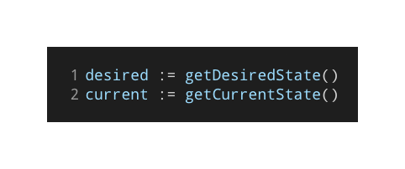
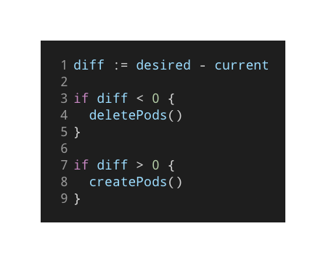
Kubernetes Controller
Kubernetes API
control loop
Watch
Check Differences
Act
Notes:
replicaset controller gets the event via the watch
checks if the desired number of pods are running
If not create or destroy

Slide 13
Questions?

Slide 14
API Versioning
Optional section marker or title
New feature development proceeds through a series of stages of increasing maturity
alpha
beta
stable
https://github.com/kubernetes/community/blob/master/contributors/devel/sig-architecture/api_changes.md#alpha-beta-and-stable-versions
Notes:
So the next topic is versioning
Specifically versions within the kubernetes api
When we extend the kubernetes api to support custom resources and we need to version them appropriately
The following conventions are adopted:
Alpha New potentially experimental functionality
Beta working but still changing
Stable prod ready

Slide 15

alpha
Kubernetes API
The version names contain alpha (e.g. v1alpha1).
May be buggy. Enabling the feature may expose bugs. Disabled by default.
Support for feature may be dropped at any time without notice.
The API may change in incompatible ways in a later software release without notice.
Recommended for use only in short-lived testing clusters, due to the increased risk of bugs and lack of long-term support.
https://kubernetes.io/docs/concepts/overview/kubernetes-api/#api-versioning
Notes:
Key Takeaway: things can change without notice

Slide 16

beta
Kubernetes API
The version names contain beta (e.g. v2beta3).
Code is well tested. Enabling the feature is considered safe. Enabled by default.
Support for the overall feature will not be dropped, though details may change.
The schema and/or semantics of objects may change in incompatible ways in a subsequent beta or stable release.
Recommended for only non-business-critical uses.
https://kubernetes.io/docs/concepts/overview/kubernetes-api/#api-versioning
Notes:
Key Takeaway: enabled by default, stable but still changing

Slide 17

stable
Kubernetes API
The version name is vX where X is an integer.
Stable versions of features will appear in released software for many subsequent versions.
https://kubernetes.io/docs/concepts/overview/kubernetes-api/#api-versioning
Notes:
Key Takeaway: Key Takeaway: stable will be supported for many versions

Slide 18
Further Reading:
https://kubernetes.io/docs/reference/using-api/#api-versioning
https://github.com/kubernetes/community/blob/master/contributors/devel/sig-architecture/api-conventions.md
https://github.com/kubernetes/community/blob/master/contributors/devel/sig-architecture/api_changes.md#changing-the-api
Notes:
Reading to understand better what the expectations are in the community around this

Slide 19
GroupVersionKind (GVK)
GroupVersionResource (GVR)
Kubernetes API
Notes:
How apis are organized in kubernetes
Kinds are like types or classes -- custom resource definitions
Ex pod type
Resources are instances of Kinds -- custom resources
Ex Specific pod

Slide 20
Kubernetes API
apiVersion: batch/v1
kind: Job
The entity Group disambiguates different APIs that may happen to have identically named Kinds. Groups often contain a domain name, such as redhat.com.
The entity Version defines the stability of the API and backward compatibility guarantees - such as v1beta1 or v1.
The entity Kind is the name of the API - such as Deployment or Service.
Notes:
Key Takeaway: we use groups to collect related API types and we call each type a Kind. using versions we afford ourselves the means to change the API over time.

Slide 21
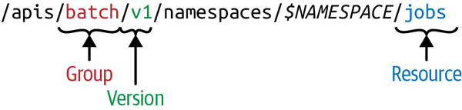
Kubernetes API
The resource Group disambiguates different APIs that may happen to have identically named Kinds.
The resource Version defines the stability of the API and backward compatibility guarantees - such as v1beta1 or v1.
The Resource is the name of the path
Notes:
Key Takeaway: a resource is the use of a particular kind in an API.
*usually this is a one-to-one relationship but not always.

Slide 22
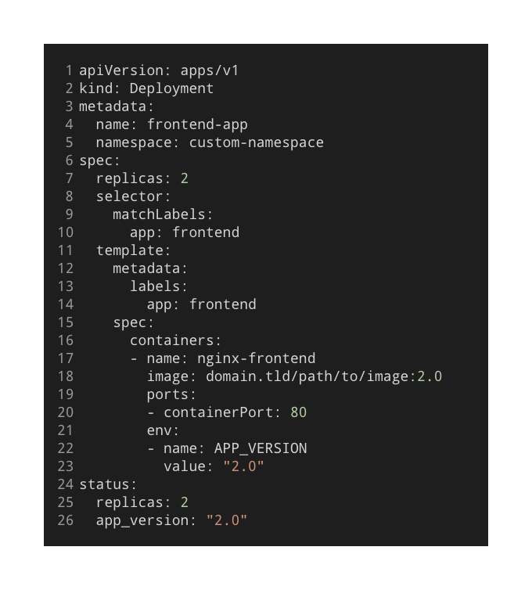
Kubernetes API
Metadata
name, namespace, selflink, resourceVersion, etc
Spec
desired state
Status
observed state(s)
List
many objects/resources
METADATA
SPEC
STATUS
Notes:
Key Takeaway: Overview of a manifest file

Slide 23
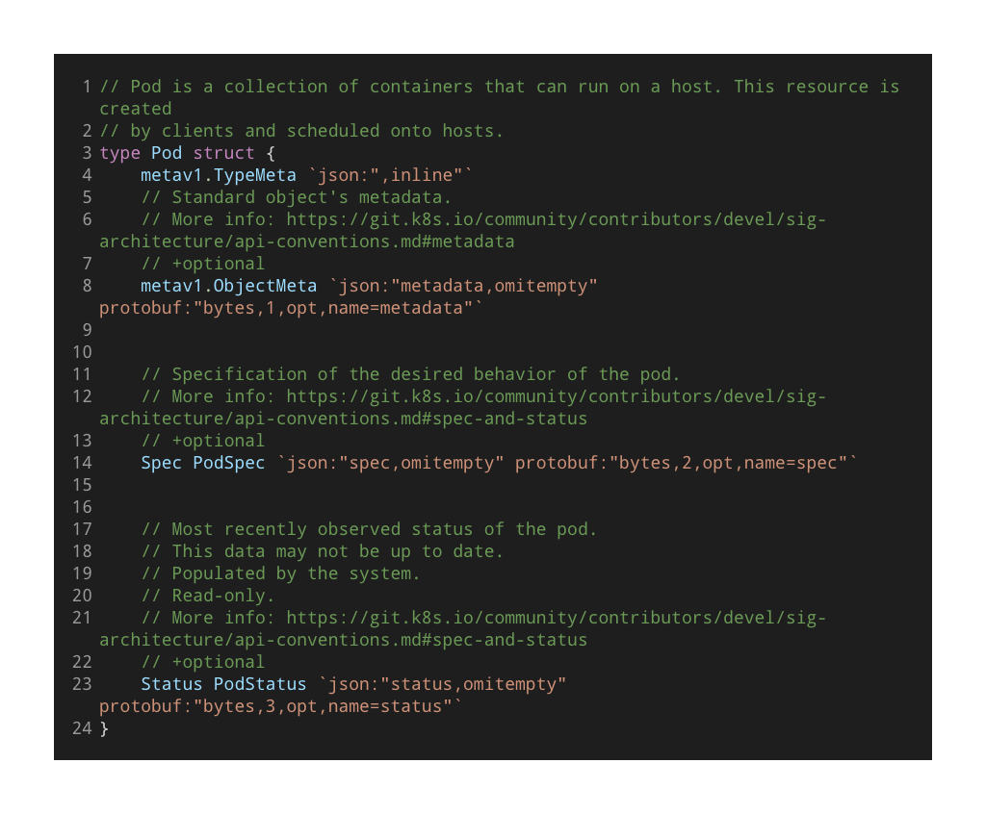
Kubernetes API
metav1.TypeMeta
TypeMeta describes an individual object in an API response or request with strings representing the type of the object and its API schema version.
metav1.ObjectMeta
ObjectMeta is metadata that all persisted resources must have, which includes all objects users must create.
Spec PodSpec
Status PodStatus
https://github.com/kubernetes/api/blob/3a2d6b5bb7f84daa2125131865eb81b151448d5b/core/v1/types.go#L3687-L3706
Notes:
Key Takeaway: kind / resource identifiers

Slide 24
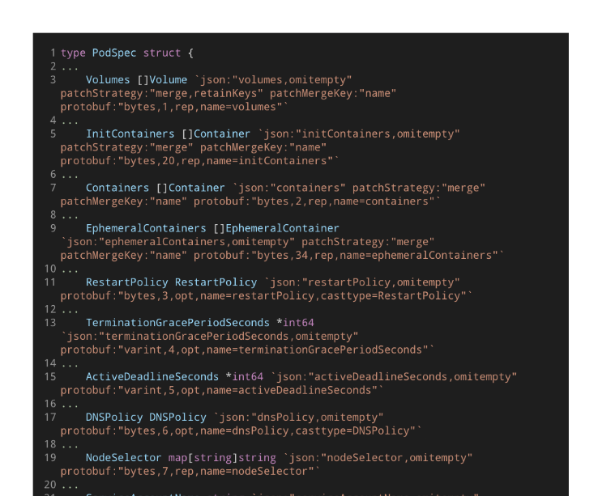
Kubernetes API
Type PodSpec
a complete description of the desired state, including configuration settings provided by the user, default values expanded by the system, and properties initialized or otherwise changed after creation by other ecosystem components (e.g., schedulers, auto-scalers), and is persisted in stable storage with the API object. If the specification is deleted, the object will be purged from the system.
https://github.com/kubernetes/community/blob/master/contributors/devel/sig-architecture/api-conventions.md#spec-and-status
Notes:
Key Takeaway: desired state, what we want

Slide 25
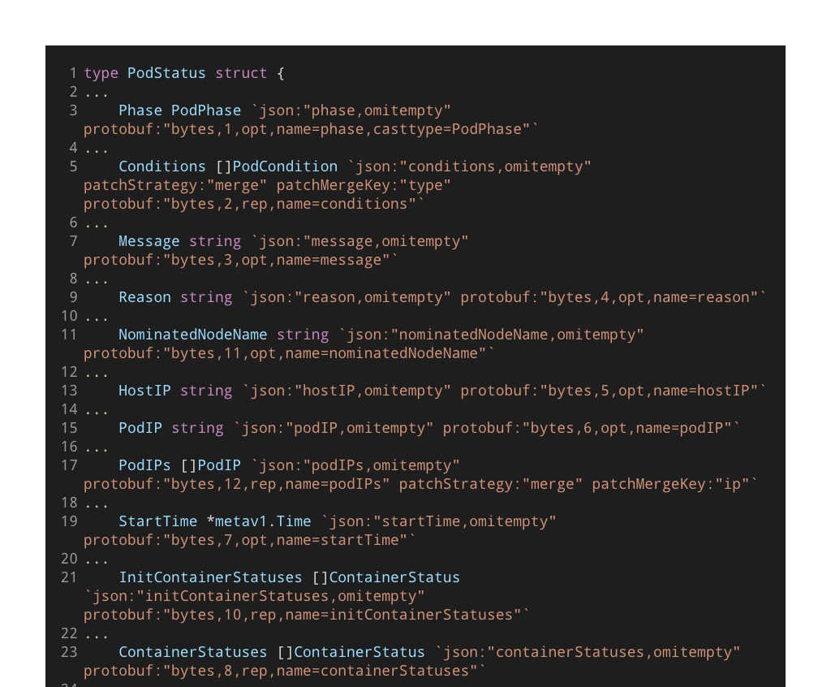
Kubernetes API
Type PodStatus
summarizes the current state of the object in the system, and is usually persisted with the object by automated processes but may be generated on the fly. At some cost and perhaps some temporary degradation in behavior, the status could be reconstructed by observation if it were lost.
https://github.com/kubernetes/community/blob/master/contributors/devel/sig-architecture/api-conventions.md#spec-and-status
Notes:
Key Takeaway: what we observe

Slide 26
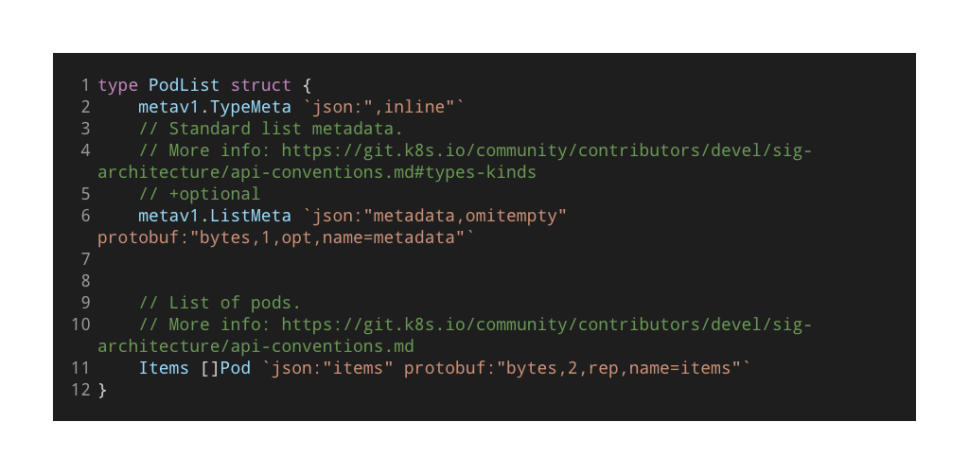
Kubernetes API
type PodList struct
Returns a collection of object in this case a slice of Pod
The name of a list kind must end with "List". Lists have a limited set of common metadata. All lists use the required "items" field to contain the array of objects they return. Any kind that has the "items" field must be a list kind.
https://github.com/kubernetes/community/blob/master/contributors/devel/sig-architecture/api-conventions.md#types-kinds
Notes:
Key Takeaway: defines lists

Slide 27
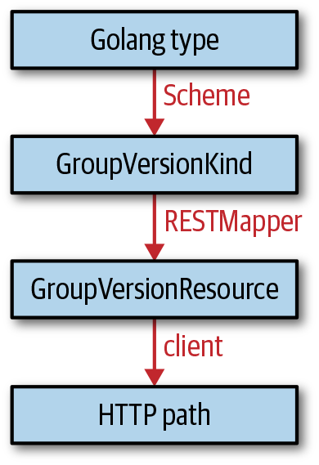
Kubernetes API
METADATA
SPEC
STATUS
Notes:
Key Takeaway:

Slide 28
Kubernetes API Actions and HTTP Methods
Verb (API) HTTP Method
Kubernetes API
get | GET
list | GET
watch | GET
create | POST
update | PUT
patch | PATCH
delete | DELETE
deletecollection | DELETE
Notes:
Key Takeaway:

Slide 29
Kubernetes Subcommand and HTTP Methods
Subcommand Object Does Not Exist Object Exists
Kubernetes API
apply | POST | PATCH | DELETE
create | POST | error!
replace | error! | PUT
delete | error! | DELETE
patch | error! | PATCH
Notes:
Key Takeaway:

Slide 30
Optimistic Concurrency: Eventually Consistent System
Notes:
We said we have many controllers all talking to the api. What about conflicts ?

Slide 31
The problem
Kubernetes API
Pessimistic Concurrency
conflicts will happen often
uses locks
Optimistic Concurrency
we believe conflicts will not happen
if they happen react in some way
The system is composed of various control loops running concurrently
Each control loop watches the API and takes an action when something (of interest to the control loop itself) changes
What happens when two control loops are trying to modify the exact same resource at the exact same time?
Notes:
Optimistic concurrency control (AKA optimistic locking) is a method that makes it possible to perform reading or updating a record without the use of the traditional locking mechanism by adding a version number and every time the data is updated, the version number increases. And Every time the client sends an update it has to send the version number. The version number gets checked to see if it has increased between the time of the client reads the data and the time it submits the update. If it did, then the update is rejected. One of the most prevalent errors one encounters when developing an operator is ‘the object has been modified; please apply your changes to the latest version and try again’.
Pessimistic concurrency control (or pessimistic locking) is called “pessimistic” because the system assumes the worst — it assumes that two or more users will want to update the same record at the same time, and then prevents that possibility by locking the record, no matter how unlikely conflicts actually are.

Slide 32
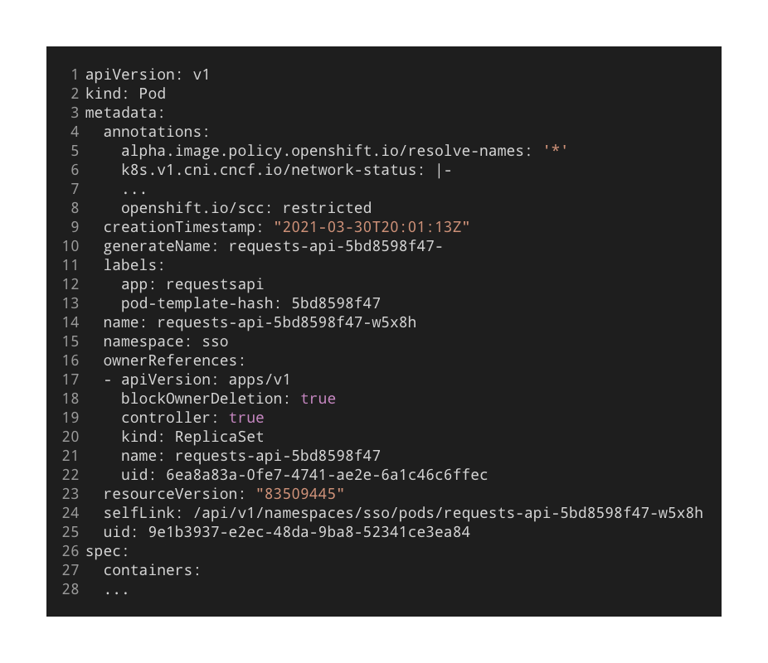
Kubernetes API
Pessimistic Concurrency
conflicts will happen often
uses locks
Optimistic Concurrency
we believe conflicts will not happen
if they happen react in some way
Notes:
When persisting an object the api server checks if the update was performed on the last version of the object or if the object has changed since the last time it was read. If it has.. Then the update is rejected and the controller has to try again.

Slide 33
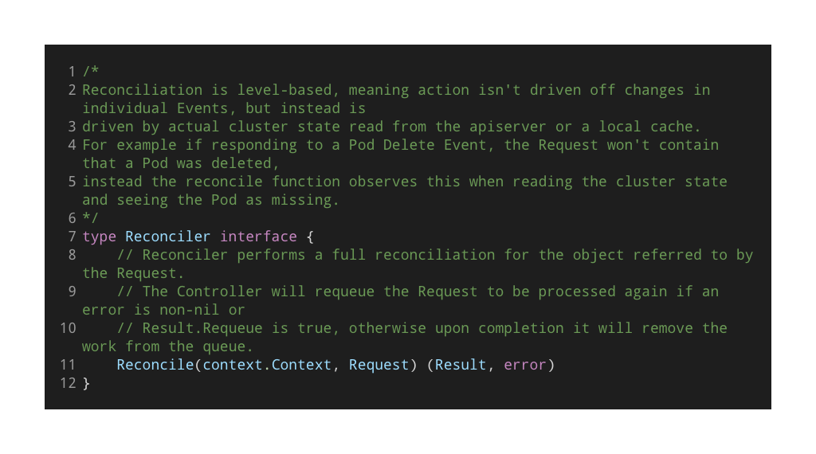
Optimistic Concurrency - Handling Conflicts
‘the object has been modified; please apply your changes to the latest version and try again’
https://github.com/kubernetes-sigs/controller-runtime/blob/933bd009d186df21911fe97a2d9511f5b922a9b7/pkg/reconcile/reconcile.go#L52-L94
Notes:
Key Take Away: Reconciliation
Edge based vs level based
When you provide `resourceVersion` to the API server upon update, it reads the value you provided and also the one available currently in etcd. If this number changed before you submitted your update, the update operation will be rejected and you’ll need to re-fetch the state of the resource and try again.

Slide 34
Garbage Collection: deleting objects that have an owner that no longer exists.
Kubernetes API

Slide 35
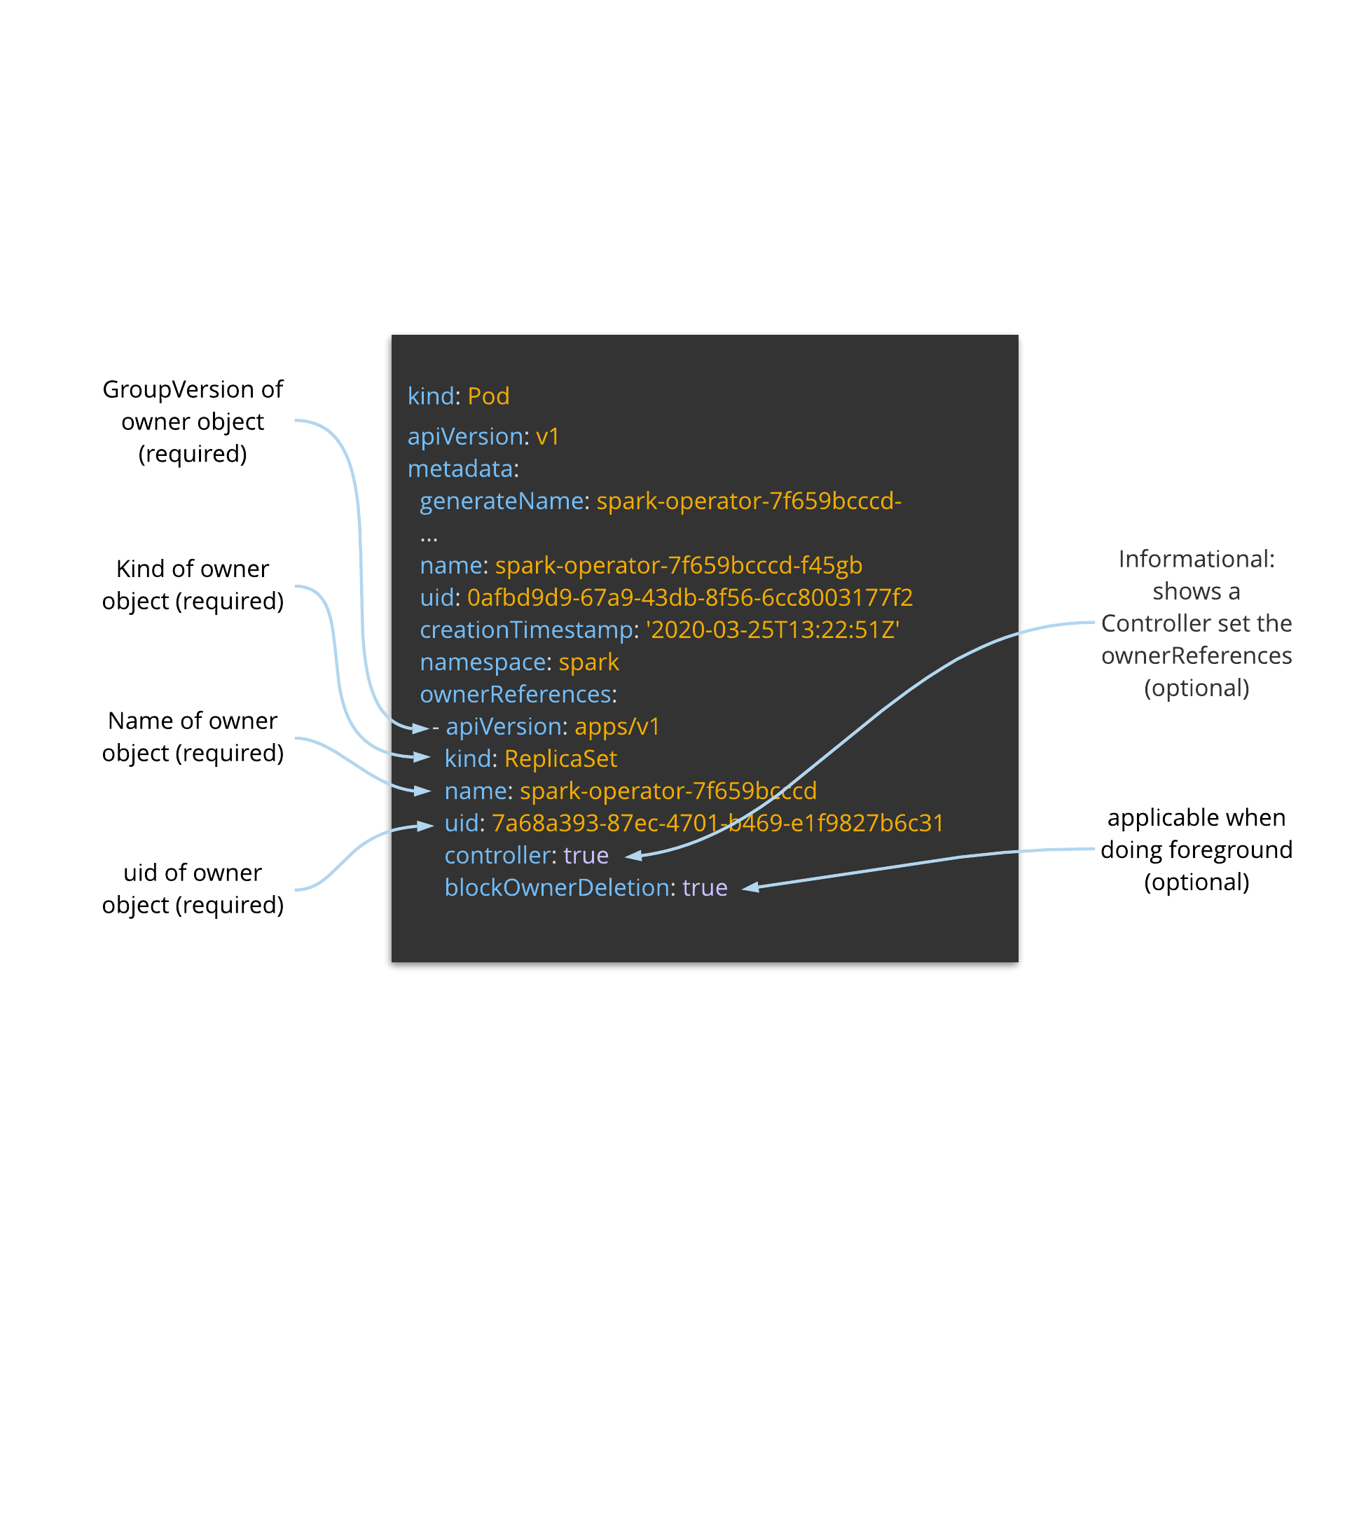
ownerReferences
Kubernetes API
Parent/child or owner/dependents Relationship
Sources:
https://kubernetes.io/docs/concepts/workloads/controllers/garbage-collection/
https://kubernetes.io/docs/tasks/access-kubernetes-api/custom-resources/custom-resource-definitions/
Notes:
An owner can have many child resources
Gc or delete cascade strategy -- foreground deletion
Owner will only be deleted after all the child resources have been deleted

Slide 36
ownerReferences
Kubernetes API
Parent/child or owner/dependents Relationship
one can decide the parent and child relationship for a pair or more number of objects
multiple owners of a dependent is possible
when a dependent has multiple owners all owners have to be “out-of-scope” for the dependent to be marked for garbage collection
Sources:
https://kubernetes.io/docs/concepts/workloads/controllers/garbage-collection/
https://kubernetes.io/docs/tasks/access-kubernetes-api/custom-resources/custom-resource-definitions/

Slide 37
Background, Foreground, and Finalizers
Kubernetes API
BACKGROUND
Kubernetes deletes the owner object immediately and the garbage collector then deletes the dependents in the background
FOREGROUND
object is still visible via the REST API
the root object first enters a “deletion in progress” state
once the garbage collector has deleted all “blocking” dependents it deletes the owner object
FINALIZERS
allow controllers to implement asynchronous pre-delete hooks
arbitrary string values, that when present ensure that a hard delete of a resource is not possible while they exist
Kubernetes only finally deletes the object if the list of finalizers is empty, meaning all finalizers have been executed
Sources:
https://kubernetes.io/docs/concepts/workloads/controllers/garbage-collection/
https://kubernetes.io/docs/tasks/access-kubernetes-api/custom-resources/custom-resource-definitions/

Slide 38
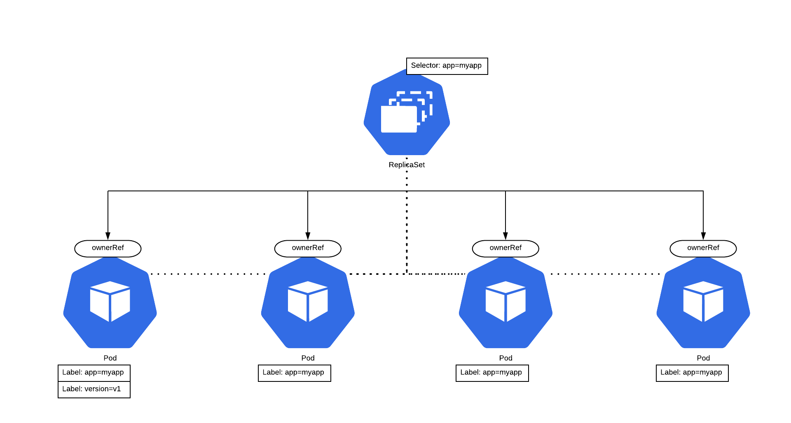
Background Deletion
Kubernetes API
oc delete -f spark-rs.yaml
curl -x DELETE http://localhost:8080/apis/apps/v1/namespaces/spark/replicasets/spark-operator-7f659bcccd \
-d ‘{“kind”:”DeleteOptions”,”apiVersion”:”v1”,”propagationPolicy”:”Background”}’ \
-H “Content-Type: application/json”
ownerReferences:
- apiVersion: apps/v1
kind: ReplicaSet
name: spark-operator-7f659bcccd
uid: 7a68a393-87ec-4701-b469-e1f9827b6c31
controller: true
blockOwnerDeletion: true
SIGTERM
SIGTERM
SIGTERM
SIGTERM
SIGKILL*
SIGKILL*
SIGKILL*
SIGKILL*
*wait 30s after SIGTERM then SIGKILL

Slide 39
Foreground Deletion
Kubernetes API
oc delete -f spark-rs.yaml
curl -x DELETE http://localhost:8080/apis/apps/v1/namespaces/spark/replicasets/spark-operator-7f659bcccd \
-d ‘{“kind”:”DeleteOptions”,”apiVersion”:”v1”,”propagationPolicy”:”Foreground”}’ \
-H “Content-Type: application/json”
ownerReferences:
- apiVersion: apps/v1
kind: ReplicaSet
name: spark-operator-7f659bcccd
uid: 7a68a393-87ec-4701-b469-e1f9827b6c31
controller: true
blockOwnerDeletion: true
DELETE
SIGTERM
SIGTERM
SIGTERM
SIGTERM
SIGKILL*
SIGKILL*
SIGKILL*
SIGKILL*
*wait 30s after SIGTERM then SIGKILL

Slide 40
Questions?
Notes:
https://learn.openshift.com/operatorframework/k8s-api-fundamentals/
Some commands to try
oc proxy --port=8080
curl http://127.0.0.1:8080/apis/batch/v1
oc get --raw /apis/batch/v1
oc api-resources
oc api-versions

Slide 41
Foreground Deletion
Kubernetes API
metadata:
deletionTimestamp: 2019-10-20T01:16:04Z
Finalizers: “foregroundDeletion”
oc delete -f spark-rs.yaml
curl -x DELETE http://localhost:8080/apis/apps/v1/namespaces/spark/replicasets/spark-operator-7f659bcccd \
-d ‘{“kind”:”DeleteOptions”,”apiVersion”:”v1”,”propagationPolicy”:”Foreground”}’ \
-H “Content-Type: application/json”
ownerReferences:
- apiVersion: apps/v1
kind: ReplicaSet
name: spark-operator-7f659bcccd
uid: 7a68a393-87ec-4701-b469-e1f9827b6c31
controller: true
blockOwnerDeletion: true
DELETE
SIGTERM
SIGTERM
SIGTERM
SIGTERM
SIGKILL*
SIGKILL*
SIGKILL*
SIGKILL*
*wait 30s after SIGTERM then SIGKILL

Slide 42
Command Line Interaction
Kubernetes API
oc proxy --port=8080
curl http://127.0.0.1:8080/apis/batch/v1
oc get --raw /apis/batch/v1
oc api-resources
oc api-versions
* kubectl and oc are essentially the same (oc utilizes the packages of kubectl)
Notes:
Key Takeaway:

Slide 43
Finalizers
Optimistic concurrency control (AKA optimistic locking) is a method that makes it possible to perform reading or updating a record without the use of the traditional locking mechanism by adding a version number and every time the data is updated, the version number increases. And Every time the client sends an update it has to send the version number. The version number gets checked to see if it has increased between the time of the client reads the data and the time it submits the update. If it did, then the update is rejected. One of the most prevalent errors one encounters when developing an operator is ‘the object has been modified; please apply your changes to the latest version and try again’.
Pessimistic concurrency control (or pessimistic locking) is called “pessimistic” because the system assumes the worst — it assumes that two or more users will want to update the same record at the same time, and then prevents that possibility by locking the record, no matter how unlikely conflicts actually are.
Kubernetes API
metadata:
deletionTimestamp: 2019-10-20T01:16:04Z
Finalizers: “foregroundDeletion”
oc delete -f spark-rs.yaml
curl -x DELETE http://127.0.0.1:8080/apis/apps/v1/namespaces/spark/replicasets/spark-operator-7f659bcccd \
-d ‘{“kind”:”DeleteOptions”,”apiVersion”:”v1”,”propagationPolicy”:”Background”}’ \
-H “Content-Type: application/json”
ownerReferences:
- apiVersion: apps/v1
kind: ReplicaSet
name: spark-operator-7f659bcccd
uid: 7a68a393-87ec-4701-b469-e1f9827b6c31
controller: true
blockOwnerDeletion: true
metadata:
deletionTimestamp: 2019-10-20T01:16:04Z
Finalizers: “foregroundDeletion”

